Slide 1
Reflection
Java Reflection

Slide 2
Reflection??
Java Reflection is a process of examining or modifying the run time behavior of a class at run time.
The java.lang.Class class provides many methods that can be used to get metadata, examine and change the run time behavior of a class.
The java.lang and java.lang.reflect packages provide classes for java reflection.
Where it is used
The Reflection API is mainly used in:
IDE (Integrated Development Environment) e.g. Eclipse, MyEclipse, NetBeans etc.
Debugger
Test Tools etc.

Slide 3
java.lang.Class class
The java.lang.Class class performs mainly two tasks:
provides methods to get the metadata of a class at run time.
provides methods to examine and change the run time behavior of a class.
Following are methods of Class

Slide 4
Method | Description
1) public String getName() | returns the class name
2) public static Class forName(String className)throws ClassNotFoundException | loads the class and returns the reference of Class class.
3) public Object newInstance()throws InstantiationException,IllegalAccessException | creates new instance.
4) public boolean isInterface() | checks if it is interface.
5) public boolean isArray() | checks if it is array.
6) public boolean isPrimitive() | checks if it is primitive.
7) public Class getSuperclass() | returns the superclass class reference.
8) public Field[] getDeclaredFields()throws SecurityException | returns the total number of fields of this class.
9) public Method[] getDeclaredMethods()throws SecurityException | returns the total number of methods of this class.
10)PublicConstructor[] getDeclaredConstructors()throws ecurityException | returns the total number of constructors of this class.
11) public Method getDeclaredMethod(String name,Class[] parameterTypes)throws NoSuchMethodException,SecurityException | returns the method class instance.

Slide 5
How to get the object of Class class?
There are 3 ways to get the instance of Class class. They are as follows:
forName() method of Class class
getClass() method of Object class
the .class syntax

Slide 6
1) forName() method of Class class
is used to load the class dynamically.
returns the instance of Class class.
It should be used if you know the fully qualified name of class.This cannot be used for primitive types.
class Simple{}
class Test{
public static void main(String args[]){
Class c=Class.forName("Simple");
System.out.println(c.getName());
}
}

Slide 7
2) getClass() method of Object class
It returns the instance of Class class. It should be used if you know the type. Moreover, it can be used with primitives.
class Simple{}
class Test{
public static void main(String args[]){
Simple simple = new Simple();
Class c= simple.getClass();
System.out.println(c.getName());
}
}

Slide 8
3) The .class syntax
If a type is available but there is no instance then it is possible to obtain a Class by appending ".class" to the name of the type.It can be used for primitive data type also.
class Test{
public static void main(String[] args) {
Class c = boolean.class;
System.out.println(c.getName());
c = Boolean.class;
System.out.println(c.getName());
c = HelloWorld.class;
System.out.println(c.getName());
}
}

Slide 9
Determining the class object
Following methods of Class class is used to determine the class object:
1) public boolean isInterface(): determines if the specified Class object represents an interface type.
2) public boolean isArray(): determines if this Class object represents an array class.
3) public boolean isPrimitive(): determines if the specified Class object represents a primitive type.

Slide 10
class Simple{}
interface My{}
class Test{
public static void main(String args[]){
try{
Class c=Class.forName("Simple");
System.out.println(c.isInterface());
Class c2=Class.forName("My");
System.out.println(c2.isInterface());
}catch(Exception e){System.out.println(e);}
}
}

Slide 11
newInstance() method class is used to create a new instance of the class.
class Simple{
void message(){System.out.println("Hello Java");}
}
class Test{
public static void main(String args[]){
try{
Class c=Class.forName("Simple");
Simple s=(Simple)c.newInstance();
s.message();
}catch(Exception e){System.out.println(e);}
}
}

Slide 12
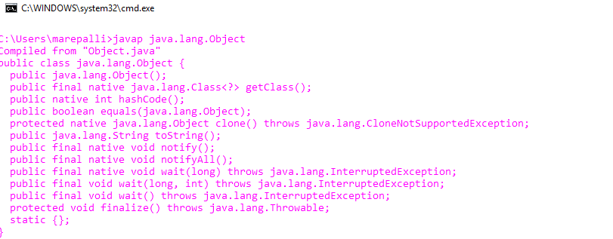
javap tool
The javap command disassembles a class file. The javap command displays information about the fields,constructors and methods present in a class file.
Syntax to use javap tool
javap fully_class_name
Example
javap java.lang.Object

Slide 13
Userdefined class code can be seen with javap
Assume You have Sample class
javap Sample

Slide 14
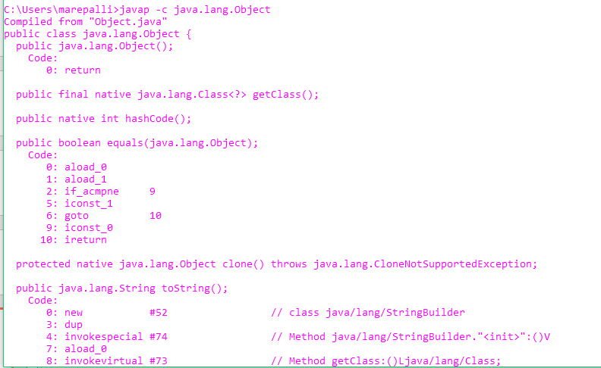
javap -c command
You can use the javap -c command to see disassembled code. The code that reflects the java bytecode.
Example: javap –c java.lang.Object

Slide 15
Important options of javap tool
Option | Description
-help | prints the help message.
-l | prints line number and local variable
-c | disassembles the code
-s | prints internal type signature
-sysinfo | shows system info (path, size, date, MD5 hash)
-constants | shows static final constants
-version | shows version information

Slide 16
Write a java program that works as java program
Following methods of java.lang.Class class can be used to display the metadata of a class.
Method | Description
Public Field[] getDeclaredFields()throws SecurityException | returns an array of Field objects reflecting all the fields declared by the class or interface represented by this Class object.
public Constructor[] getDeclaredConstructors()throws SecurityException | returns an array of Constructor objects reflecting all the constructors declared by the class represented by this Class object.
public Method[] getDeclaredMethods()throws SecurityException | returns an array of Method objects reflecting all the methods declared by the class or interface represented by this Class object.

Slide 17
import java.lang.reflect.Constructor;
import java.lang.reflect.Field;
import java.lang.reflect.Method;
public class MyJavap {
public static void main(String[] args) throws ClassNotFoundException {
Class c = Class.forName("HelloWorld");
System.out.println("Class name: "+c.getName());
System.out.println("*******Fields********");
Field[] fields = c.getDeclaredFields();
for (Field field : fields) {
System.out.println(field);
}
System.out.println("********Constructors******");
Constructor[] declaredConstructors = c.getDeclaredConstructors();
for (Constructor constructor : declaredConstructors) {
System.out.println(constructor);
}
System.out.println("********Methods**********");
Method[] declaredMethods = c.getDeclaredMethods();
for (Method method : declaredMethods) {
System.out.println(method);
}}}

Slide 18
Output
*******Fields********
int HelloWorld.x
int HelloWorld.b
********Constructors******
HelloWorld()
********Methods**********
public static void HelloWorld.main(java.lang.String[])

Slide 19
Create your own appletviewer
As you know well that appletviewer tool creates a frame and displays the output of applet in the frame.You can also create your frame and display the applet output.
class MyApplet extends JApplet {
@Override
public void paint(Graphics g) {
g.drawString("Welcome", 50, 50);
}
}

Slide 20
public class MyViewer extends JFrame {
public MyViewer() throws ClassNotFoundException, InstantiationException, IllegalAccessException {
Class c = Class.forName("MyApplet");
setTitle("My Viewer");
setSize(500, 500);
setLayout(null);
setVisible(true);
JApplet applet = (JApplet) c.newInstance();
applet.start();
Graphics g = getGraphics();
applet.paint(g);
applet.stop();
}
public static void main(String[] args) throws ClassNotFoundException, InstantiationException, IllegalAccessException {
new MyViewer();
}
}

Slide 21
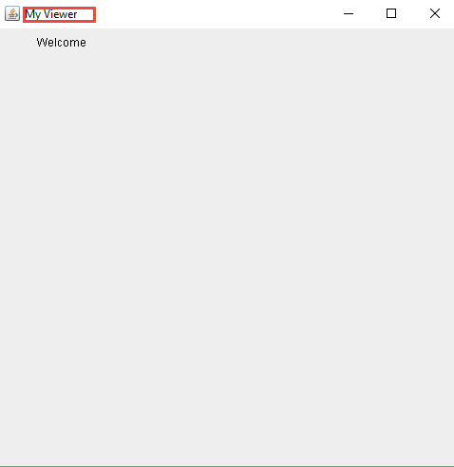
Output

Slide 22
How to call private methods, private fields from another class in java
You can call the private method from outside the class by changing the runtime behavior of the class.
By the help of java.lang.Class class and java.lang.reflect.Method class, we can call private method from any other class.
1) public void setAccessible(boolean status) throws SecurityException sets the accessibility of the method.
2) public Object invoke(Object method, Object... args) throws IllegalAccessException, IllegalArgumentException, InvocationTargetException is used to invoke the method.

Slide 23
Example of calling private methods, field from another class
Create class with private methods
public class Hello {
private int id = 200;
private void sayHello(){
System.out.println("Hello namaste !!");
}
private void square(int n){
System.out.println(n*n);
}
}

Slide 24
public class AccessPrivateMethods {
public static void main(String[] args) throws Exception{
Class c = Class.forName("Hello");
Hello obj = (Hello) c. newInstance();
Method method = c.getDeclaredMethod("sayHello", null);
method.setAccessible(true);
method.invoke(obj, null);
method = c.getDeclaredMethod("square", new Class[]{int.class});
method.setAccessible(true);
method.invoke(obj,2);
Field field = c.getDeclaredField("id");
field.setAccessible(true);
System.out.println(field.get(obj));
}
}

Slide 25
output
Hello Namaste !!
Square of the no. is: 4
200

Slide 26
Difference between getMethods() and getDeclaredMethods()
→ getDeclaredMethods includes all methods declared by the class itself,
→ whereas getMethods returns only public methods, but also those inherited from a base class (here from java.lang.Object).

